Slide 1



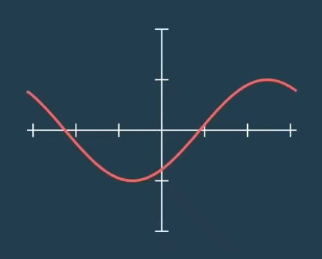
Trigonometric DSP "CORDIC IP" Coordinate Rotational Digital Computer
Mohamed Elsayed Ali
Abdullah Tarek Mohamed Hashish
Khaled Taher Ahmed Mohamed Fouad

Slide 2
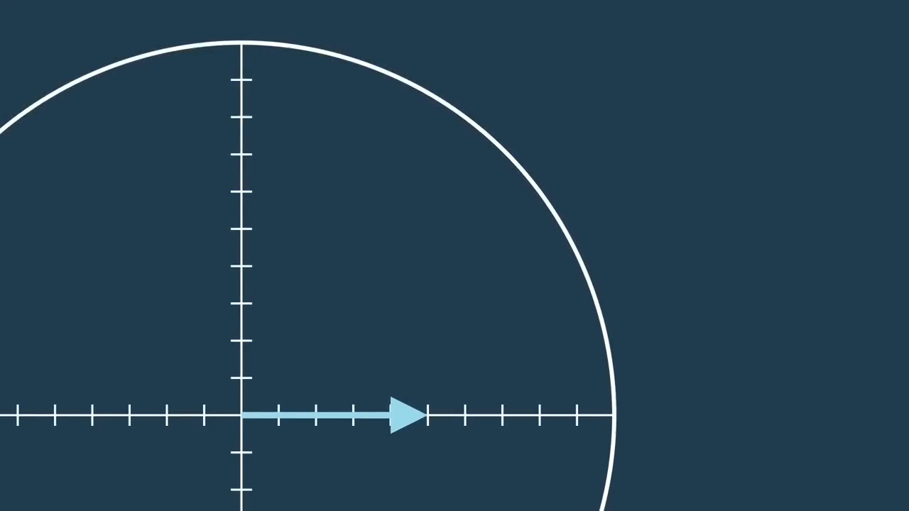
Agenda
Introduction.
P1: Polar To Rectangle ( Sin & Cos calculations).
P2: Rectangle To Polar.
Limitations & Synthesis Results.
IP Simulation.
CORDIC IP & AXI Integration.
SOC Simulation.

Slide 3
Introduction
Due to rapid advances made in VLSI technology, there is an entirely different approach towards computer design for real time applications.
Many of the DSP applications try to closely simulate real time images.
Trigonometric function calculation is one of the primary tasks performed in DSP applications.

Slide 4
Introduction
CORDIC (Coordinate Rotation Digital Computer) is a method for computing elementary functions using minimal hardware such as shifts, adds/subs and compares.
CORDIC works by rotating the coordinate system through constant angles until the angle is reduces to zero.
Only bit-shift, addition and subtraction operations in combination with a lookup-table is required.

Slide 5
Introduction
The IP core can be configured for one of the following functions:
Polar to rectangular coordinate translation.
Rectangular to polar coordinate translation.
Sine and cosine computation.

Slide 6
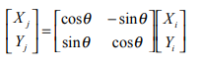
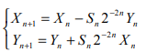
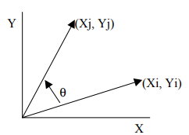
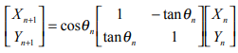
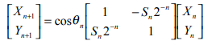
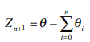
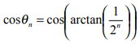
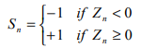
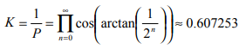
P1: Polar To Rectangle ( Sin & Cos calculations).
The CORDIC algorithm performs a planar rotation.
Graphically, planar rotation means transforming a vector (Xi, Yi) into a new vector (Xj, Yj).

Slide 7
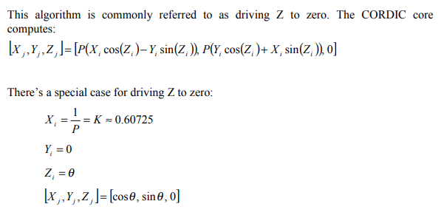
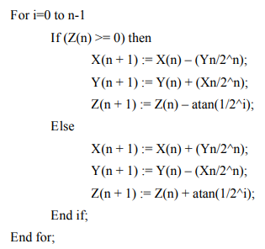

P1: Polar To Rectangle ( Sin & Cos calculations).

Slide 8
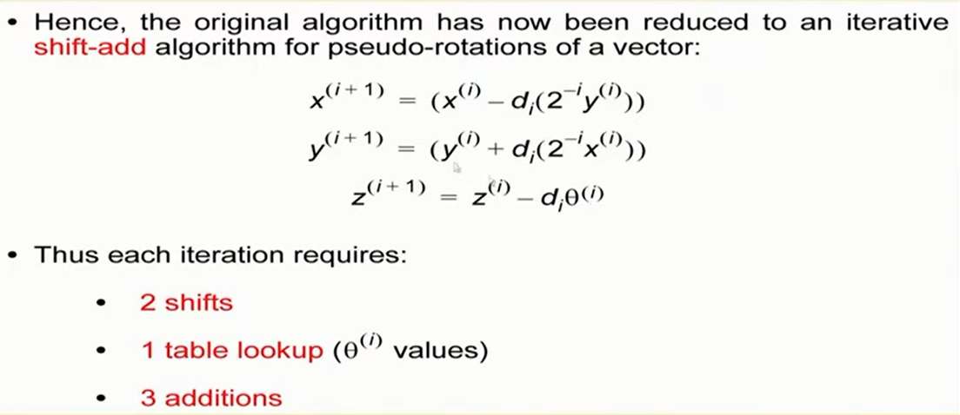
P1: Polar To Rectangle ( Sin & Cos calculations).

Slide 9
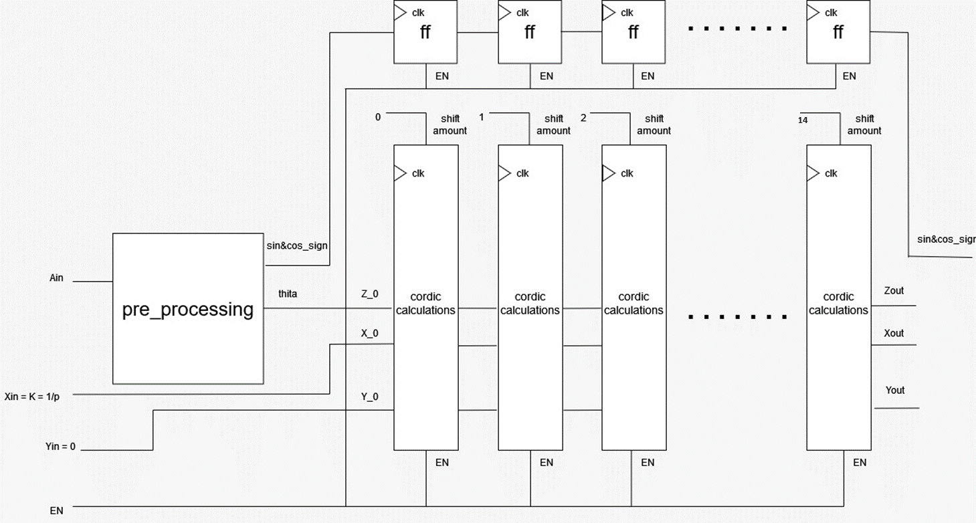
P1: Polar To Rectangle ( Sin & Cos calculations).

Slide 10
P1: Polar To Rectangle ( Sin & Cos calculations).
000 represents 0 and 111 represents 1. Any binary between 000 and 111 will represent numbers between 0 and 1 i.e. various decimal point numbers.
In CORDIC_IP 16-bit-binary scaling system to represent angles from 0 to 360 , with a very high resolution of (360/2^16).
- Ain is equal the actual angel multiplied with ((2^16) /360) . - Output actual sin value is equal sin_val multiplied with (1/(2^15)). - Output actual cos value is equal cos_val multiplied with (1/(2^15)).

Slide 11
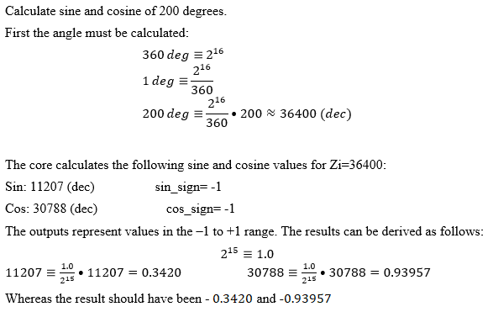
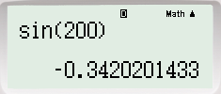
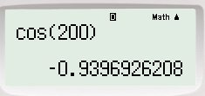
P1: Polar To Rectangle ( Sin & Cos calculations).

Slide 12
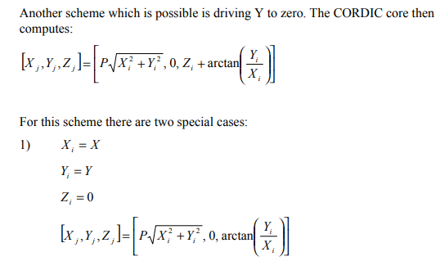
The rectangular to polar coordinate processor is built around the second CORDIC scheme which calculates:
P2:Rectangle To Polar.

Slide 13
P2: Rectangle To Polar.
Pre-processing: to get the data ready for the CORDIC we must:
- If (Y > X) exchange X & Y to get more accuracy.
- Translate X,Y to first quarter (+X,+Y).
Post-processing: to get the actual angle and radius from the CORDIC we must:
- Divide radius by P.
- Translate angle to actual quarter.

Slide 14
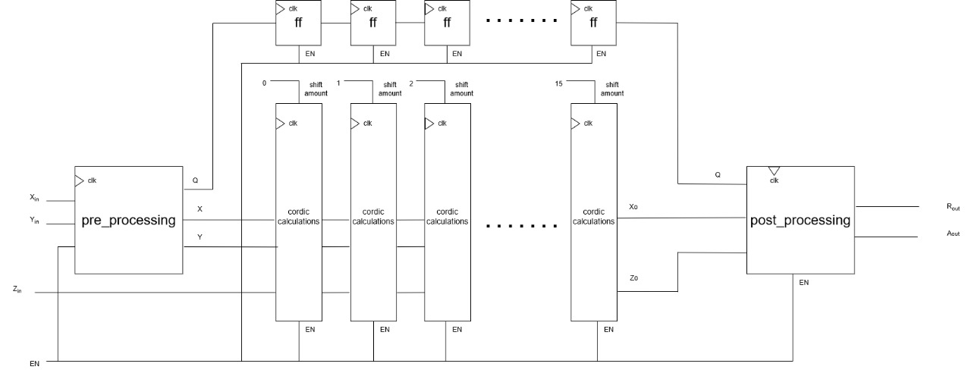
P2:Rectangle To Polar.

Slide 15
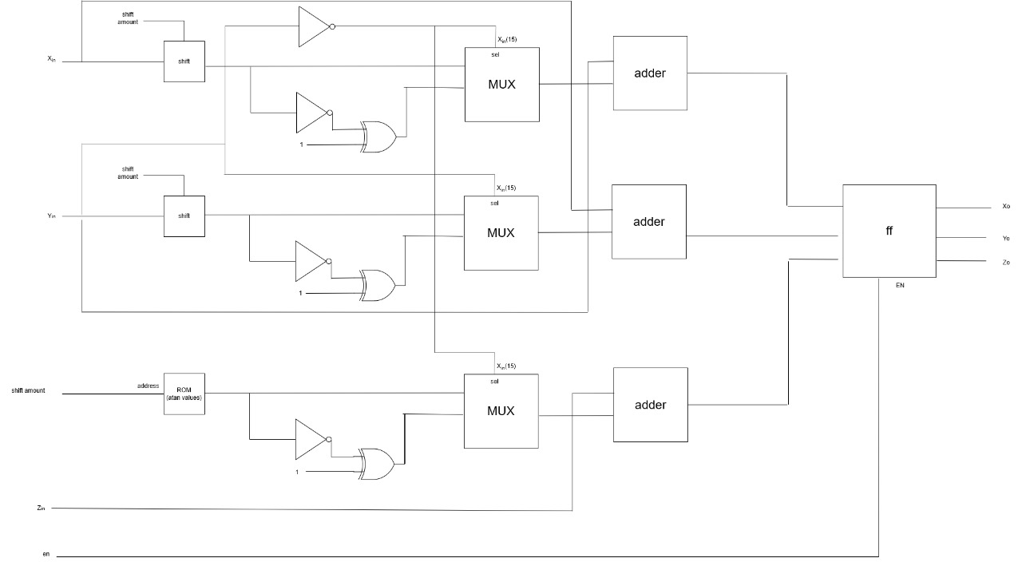
P2:Rectangle To Polar.

Slide 16
Limitations & Synthesis Results.
Limitations.
Input angle range in P2R-core ( 0 : 360 degrees ).
Error Precession = 0.00588 % (16 bits data width).
Speed
Operating Frequency is 285.7 MHz and MAX-Frequency is 289.855 MHz
Maximum of 15 clock cycles to obtain the output results (using a pipeline of 15 stages).

Slide 17
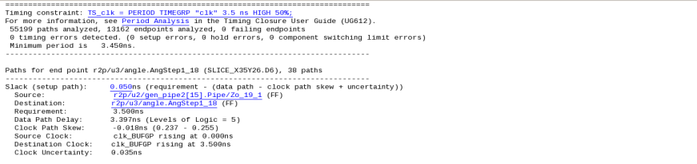
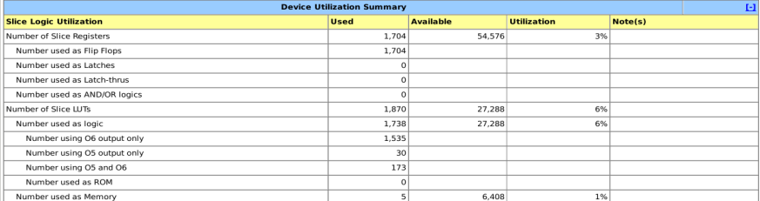

Limitations & Synthesis Results.
Timing Report.
Utilization Report.

Slide 18
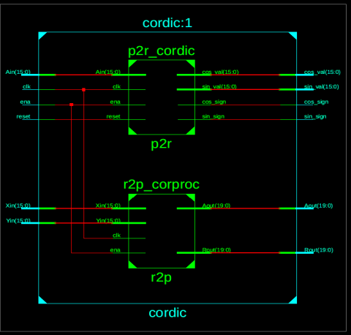
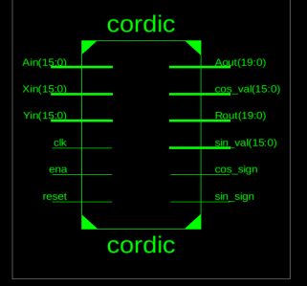
Limitations & Synthesis Results.
RTL Viewer.

Slide 19
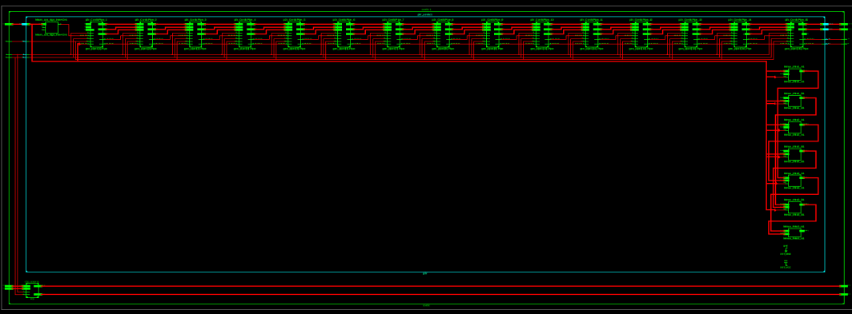
Limitations & Synthesis Results.
RTL Viewer.

Slide 20
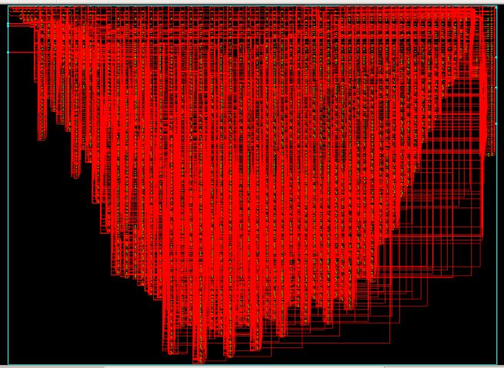
Limitations & Synthesis Results.
Technology Viewer.

Slide 21
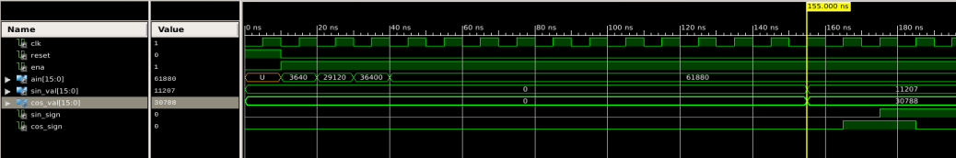
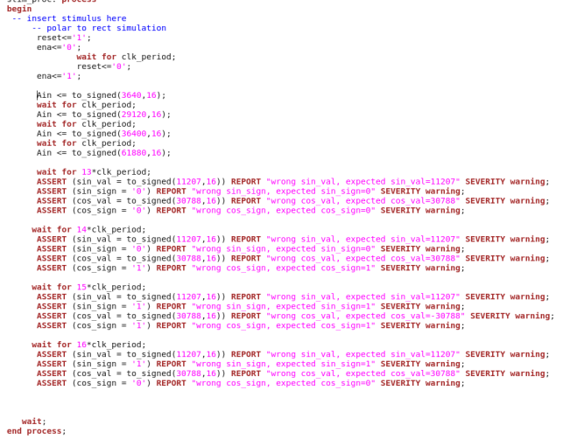
IP Simulation

Slide 22
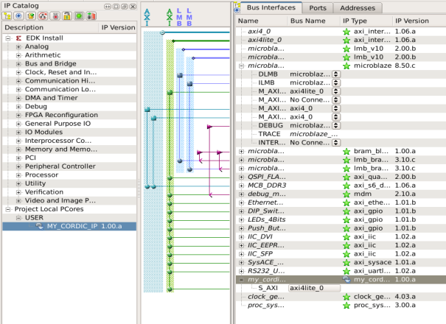
CORDIC IP & AXI Integration.

Slide 23
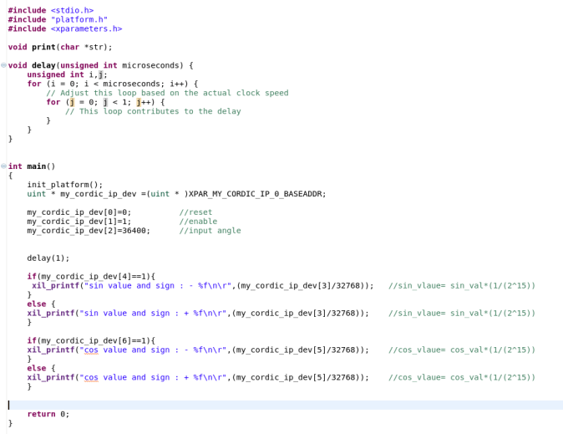
SOC Simulation.

Slide 24
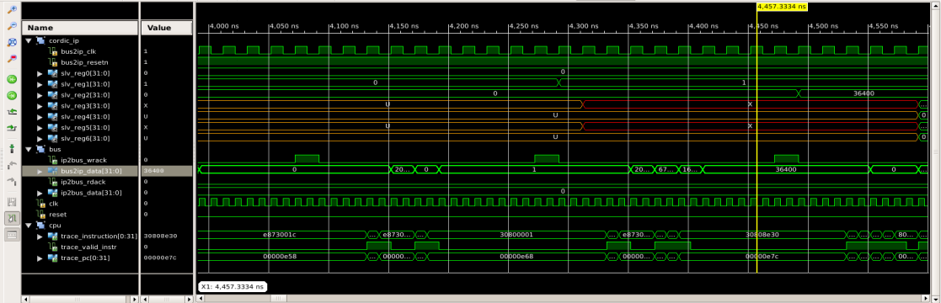
SOC Simulation.

Slide 25
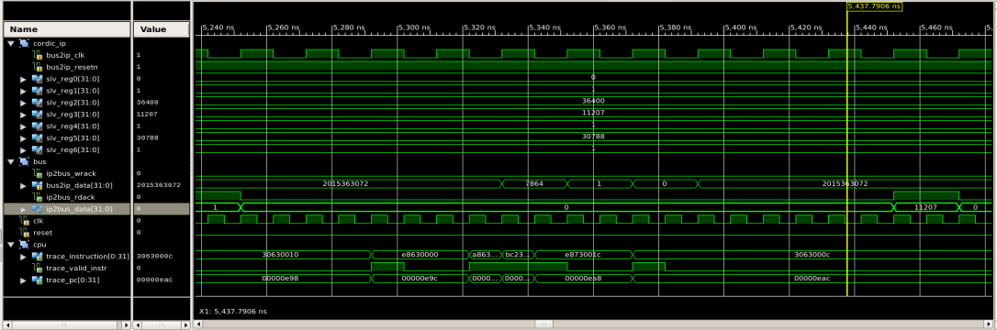
SOC Simulation.

Slide 26
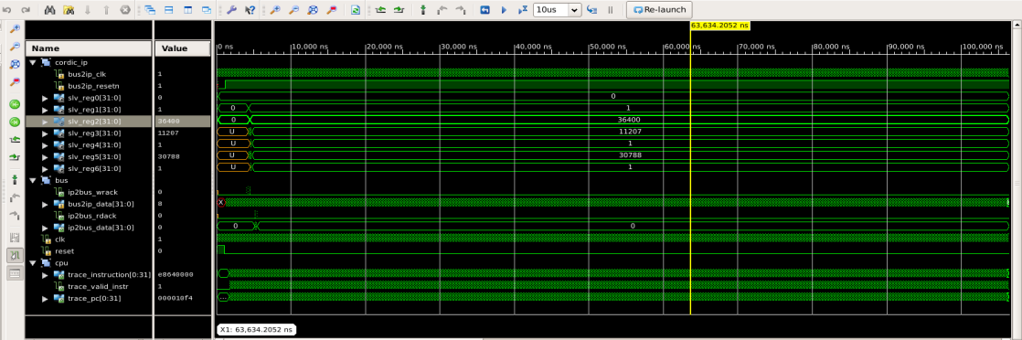
SOC Simulation.

Slide 27
Thank you

